Slide 1
CSE 440
Artificial Intelligence
Uninformed Search
Dr. Mohammad Mahmudul Alam
Department of Electrical & Computer Engineering (ECE)
North South University (NSU)

Slide 2
Search: The Core Idea
Search: process of constructing sequences of actions that achieve a goal given a problem.
It is assumed that the environment is observable, deterministic, static and completely known.
For any problem:
The world is (always) in some state.
Agents take actions, which change the state.
We need a sequence of actions that gets the world into a particular goal state.
To find it, we search the space of actions and states.
Searching is not (always) the same as doing!

Slide 3
What’s a State?
The current value of everything in the agent’s “world”
Everything in the problem representation
Values of all parameters at a particular point in time
Examples:
Chess board: 8x8 grid, location of all pieces
Tic-tac-toe: 3x3 grid, whether each is X, O, or open
Robot soccer: Location of all players, location of ball, possibly last known trajectory of all players (if sequential)
Travel: Cities, distances between cities, agent’s current city

Slide 4
Formulating Search Problem
Formulating a problem requires specifying five components:
State representation: A set of possible states that the environment can be in. We call this the state space.
Initial state: state that the agent starts in.
Goal state: A set of one or more goal states.
Actions (operators): The actions available to the agent.
Action/Path cost function: A problem-solving agent should use a cost function that reflects its own performance measure
A sequence of actions forms a path, and a solution is a path from the initial state to a goal state.
An optimal solution has the lowest path cost among all solutions.

Slide 5
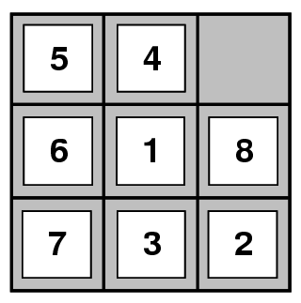
8-Puzzle
State: 3 x 3 array describing where tiles are
Operators: Move blank square Left, Right, Up or Down
Initial State: Starting configuration of the board
Goal: Some specific board configuration

Slide 6
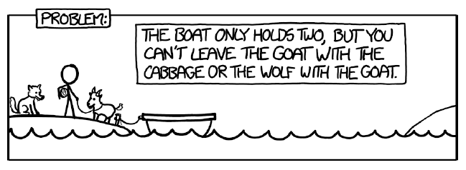
River Problem
1 sheep, 1 wolf, 1 cabbage, 1 boat
Goal: Move everything across the river.
Constraints:
The boat can hold you plus one thing.
Wolf can never be alone with sheep.
Sheep can never be alone with cabbage.
State: Location of sheep, wolf, cabbage on shores and boat.
Operators: Move ferry containing some set of occupants across the river (in either direction) to the other side.

Slide 7
Formalizing Search
A state space can be represented as a search tree/graph (V, E):
V is a set of nodes (states)
E is a set of arcs (actions)
Root is the initial state and
Each arc is directed from a node to another node
Each arc has a fixed, positive cost
Approach:
Expand: Generate all successor nodes of a given node
- “What nodes can I reach from here (by taking what actions)?”
Goal-Test: Test if state satisfies goal conditions
Queuing-Function: Used to maintain a ranked list of nodes that are candidates for expansion
- “What should I explore next?”

Slide 8
Search Example: River Problem
Let’s consider the River Problem:
A farmer wishes to carry a wolf, a duck and corn across a river, from the south to the north shore. The farmer is the proud owner of a small rowing boat called Bounty which he feels is easily up to the job. Unfortunately the boat is only large enough to carry at most the farmer and one other item. Worse again, if left unattended the wolf will eat the duck and the duck will eat the corn.
How can the farmer safely transport the wolf, the duck and the corn to the opposite shore?
River
boat
Farmer, Wolf,
Duck and Corn

Slide 9
Search Example: River Problem
The River Problem:
F=Farmer W=Wolf D=Duck C=Corn /=River
How can the farmer safely transport the wolf, the duck and the corn to the opposite shore?
-/FWCD
FWCD/-

Slide 10
Search Example: River Problem
Problem formulation:
  State representation: location of farmer and items in both sides of river
  [items in South shore / items in North shore] : (FWDC/-, FD/WC, C/FWD …)
  Initial State: farmer, wolf, duck and corn in the south shore FWDC/-
  Goal State: farmer, duck and corn in the north shore
  -/FWDC
  Operators: the farmer takes in the boat at most one item from one side to the other side
  (F-Takes-W, F-Takes-D, F-Takes-C, F-Takes-Self [himself only])
  Path cost: the number of crossings

Slide 11
State space:
A problem is solved by moving from the initial state to the goal state by applying valid operators in sequence. Thus the state space is the set of states reachable from a particular initial state.
Initial state
Dead ends
Illegal states
repeated state
intermediate state
Goal state

Slide 12
Problem solution:
A problem solution is simply the set of operators (actions) needed to reach the goal state from the initial state:
F-Takes-D, F-Takes-Self, F-Takes-W,
F-Takes-D, F-Takes-C, F-Takes-Self,
F-Takes-D.

Slide 13
Problem solution: (path Cost = 7)
While there are other possibilities here is one 7 step solution to the river problem
F
D
D
F
W
D
F-Takes-D
F-Takes-S
F-Takes-W
F
W
D
C
W
C
F
W
C
C
Initial State
WC/FD
FWC/D
C/FWD
F-Takes-D
F
W
G
C
W
C
F
W
C
W
F-Takes-D
F-Takes-S
F-Takes-C
F
D
D
F
D
C
Goal State
FD/WC
D/FWC
FDC/W

Slide 14
Searching for a solution:
We start with the initial state and keep using the operators to expand the parent nodes till we find a goal state.
…but the search space might be large…
…really large…
So, we need some systematic way to search.

Slide 15
Search Algorithms
Uninformed (Blind) search: breadth-first, depth-first, depth limited, iterative deepening, and bidirectional search
Informed (Heuristic) search: search is guided by an evaluation function: Greedy best-first, A*, IDA*, and beam search
Optimization in which the search is to find an optimal value of an objective function: hill climbing, simulated annealing, genetic algorithms, Ant Colony Optimization
Game playing, an adversarial search: minimax algorithm, alpha-beta pruning

Slide 16
Evaluating Search Algorithms
Completeness:
- Guarantees finding a solution if one exists
Time complexity:
- How long (worst or average case) does it take to find a solution?
- Usually measured in number of states visited/nodes expanded
Space complexity:
- How much space is used by the algorithm?
- Usually measured in maximum size of the “nodes” list during search
Optimality / Admissibility:
- If a solution is found, is it guaranteed to be optimal
- an admissible algorithm will find a solution with minimum cost

Slide 17
Time and Space Complexity
Time and space complexity are measured in terms of:
The average number of new nodes we create when expanding a new node is the (effective) branching factor b.
The (maximum) branching factor b is defined as the maximum nodes created when a new node is expanded.
The length of a path to a goal is the depth d.
The maximum length of any path in the state space m.

Slide 18
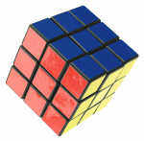
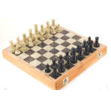
Branching Factors for Some Problems
The eight puzzle has a (effective) branching factor of 2.13, so a search tree at depth 20 has about 3.7 million nodes: O(b^{d})
Rubik’s cube has a (effective) branching factor of 13.34. There are 901,083,404,981,813,616 different states. The average depth of a solution is about 18.
Chess has a branching factor of about 35, there are about 10¹²⁰ states (there are about 10⁷⁹ electrons in the universe).
2
1
3
4
7
6
5
8

Slide 19
Search Algorithms
Uninformed (“blind”) search:
Use no information about the “direction” of the goal node(s)
Ex. Breadth-first, depth-first, depth-limited, uniform-cost, depth-first iterative deepening, bidirectional
Informed (“heuristic”) search (next class)
Use domain information to (try to) head in the general direction of the goal node(s)
Hill climbing, best-first, greedy search, beam search, A, A*

Slide 20
Uninformed Search
Breadth-first search
Uniform-cost search
Depth-first search
Depth-limited search
Iterative deepening search
Bidirectional search

Slide 21
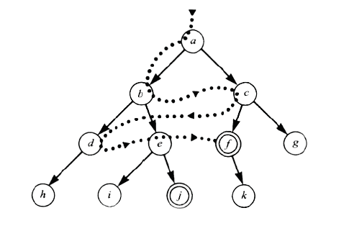
Breadth First Search

Slide 22
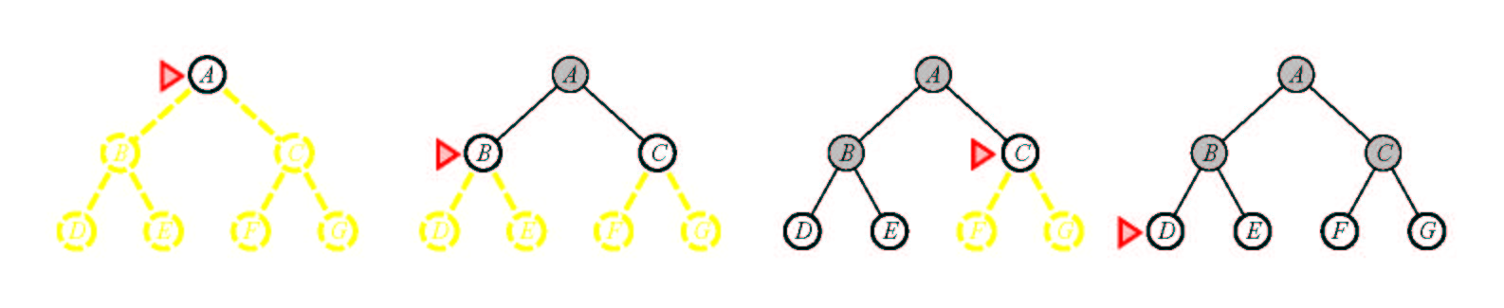
Breadth First Search
Main idea: Expand all nodes at depth (i) before expanding nodes at depth (i + 1)
Level-order Traversal.
Implementation: Use of a First-In-First-Out queue (FIFO). Nodes visited first are expanded first. Enqueue nodes in FIFO (first-in, first-out) order.
Complete? Yes.
Optimal? Yes, if path cost is nondecreasing function of depth
Time Complexity: O(b^{d})
Space Complexity: O(b^{d}), note that every node in the fringe is kept in the queue.

Slide 23
Breadth First Search
Given the following state space (tree search), give the sequence of visited nodes when using BFS (assume that the node O is the goal state):
A
B
C
D
E
F
G
H
I
J
K
L
M
N
O

Slide 24
Breadth First Search
A,
A
B
C
D
E

Slide 25
Breadth First Search
A,
B,
A
B
C
D
E
F
G

Slide 26
Breadth First Search
A,
B,C
A
B
C
D
E
F
G
H

Slide 27
Breadth First Search
A,
B,C,D
A
B
C
D
E
F
G
H
I
J

Slide 28
Breadth First Search
A,
B,C,D,E
A
B
C
D
E
F
G
H
I
J

Slide 29
Breadth First Search
A,
B,C,D,E,
F,
A
B
C
D
E
F
G
H
I
J

Slide 30
Breadth First Search
A,
B,C,D,E,
F,G
A
B
C
D
E
F
G
H
I
J
K
L

Slide 31
Breadth First Search
A,
B,C,D,E,
F,G,H
A
B
C
D
E
F
G
H
I
J
K
L

Slide 32
Breadth First Search
A,
B,C,D,E,
F,G,H,I
A
B
C
D
E
F
G
H
I
J
K
L
M

Slide 33
Breadth First Search
A,
B,C,D,E,
F,G,H,I,J,
A
B
C
D
E
F
G
H
I
J
K
L
M
N

Slide 34
Breadth First Search
A,
B,C,D,E,
F,G,H,I,J,
K,
A
B
C
D
E
F
G
H
I
J
K
L
M
N

Slide 35
Breadth First Search
A,
B,C,D,E,
F,G,H,I,J,
K,L
A
B
C
D
E
F
G
H
I
J
K
L
M
N
O

Slide 36
Breadth First Search
A,
B,C,D,E,
F,G,H,I,J,
K,L, M,
A
B
C
D
E
F
G
H
I
J
K
L
M
N
O

Slide 37
Breadth First Search
A,
B,C,D,E,
F,G,H,I,J,
K,L, M,N,
A
B
C
D
E
F
G
H
I
J
K
L
M
N
O

Slide 38
Breadth First Search
A,
B,C,D,E,
F,G,H,I,J,
K,L, M,N,
Goal state: O
A
B
C
D
E
F
G
H
I
J
K
L
M
N
O

Slide 39
Breadth First Search
The returned solution is the sequence of operators in the path:
A, B, G, L, O
A
B
C
D
E
F
G
H
I
J
K
L
M
N
O

Slide 40
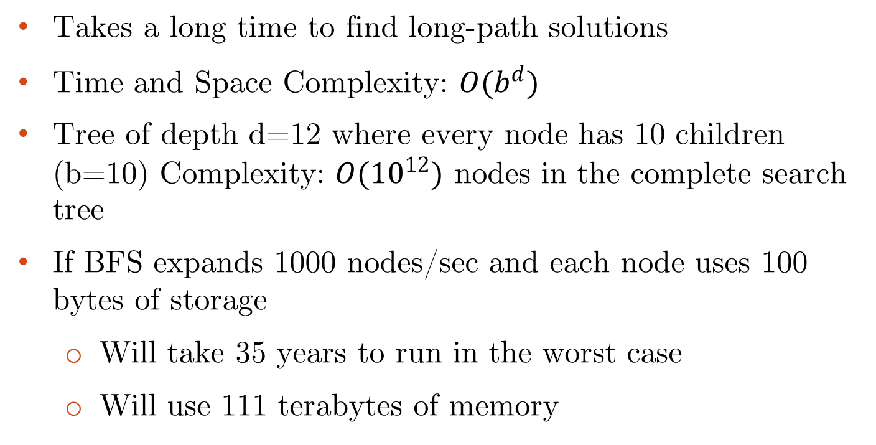
Breadth First Search
Takes a long time to find long-path solutions
Time and Space Complexity: $O(b^{d})$
Tree of depth d=12 where every node has 10 children (b=10) Complexity: $O({10}^{12})$ nodes in the complete search tree
If BFS expands 1000 nodes/sec and each node uses 100 bytes of storage
  Will take 35 years to run in the worst case
  Will use 111 terabytes of memory

Slide 41
Uniform Cost Search
“Dijkstra’s Algorithm” in literature
For each frontier node, save the total cost of the path from the initial state to that node
Expand the frontier node with the lowest path cost
Equivalent to breadth-first if step costs all equal
/dike-stra/

Slide 42
Uniform Cost Search
5
2
[5]
[2]
1
4
1
7
[6]
[3]
[9]
[9]
Goal state
4
5
[x] = g(n)
path cost of node n
[7]
[8]

Slide 43
Uniform Cost Search
5
2
[5]
[2]

Slide 44
Uniform Cost Search
5
2
[5]
[2]
1
7
[3]
[9]

Slide 45
Uniform Cost Search
5
2
[5]
[2]
1
7
[3]
[9]
4
5
[7]
[8]

Slide 46
Uniform Cost Search
5
2
[5]
[2]
1
4
1
7
[6]
[3]
[9]
[9]
4
5
[7]
[8]

Slide 47
Uniform Cost Search
5
2
[5]
[2]
Goal state path cost g(n)=[6]
1
4
1
7
[3]
[9]
[9]
4
5
[7]
[8]

Slide 48
Uniform Cost Search (UCS)
Uniform Cost Search
5
2
[5]
[2]
1
4
1
7
[6]
[3]
[9]
[9]
4
5
[7]
[8]

Slide 49





Uniform Cost Search
In case of equal step costs, Breadth First search finds the optimal solution.
For any step-cost function, Uniform Cost search expands the node n with the lowest path cost.
UCS takes into account the total cost: g(n).
UCS is guided by path costs rather than depths. Nodes are ordered according to their path cost.

Slide 50
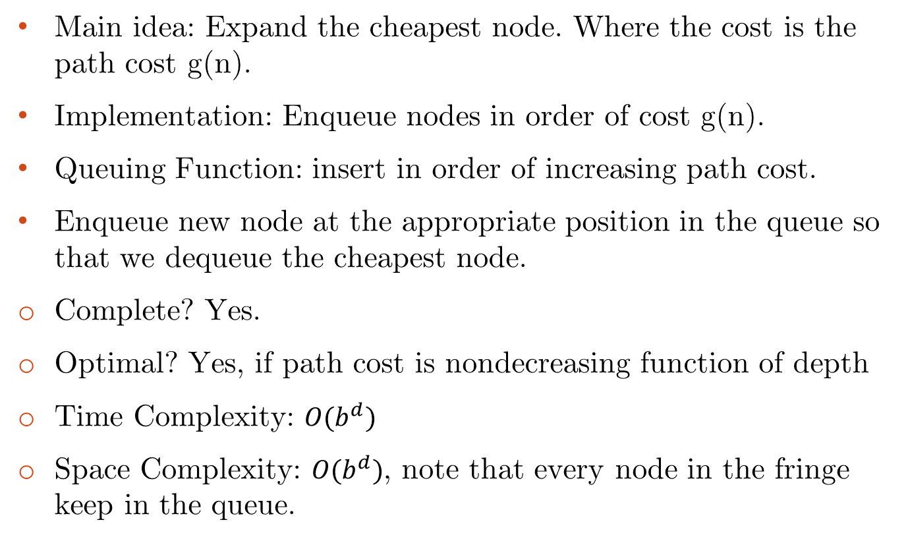
Uniform Cost Search
Main idea: Expand the cheapest node. Where the cost is the path cost g(n).
Implementation: Enqueue nodes in order of cost g(n).
Queuing Function: insert in order of increasing path cost.
Enqueue new node at the appropriate position in the queue so that we dequeue the cheapest node.
Complete? Yes.
Optimal? Yes, if path cost is nondecreasing function of depth
Time Complexity: $O(b^{d})$
Space Complexity: $O(b^{d})$, note that every node in the fringe keep in the queue.

Slide 51
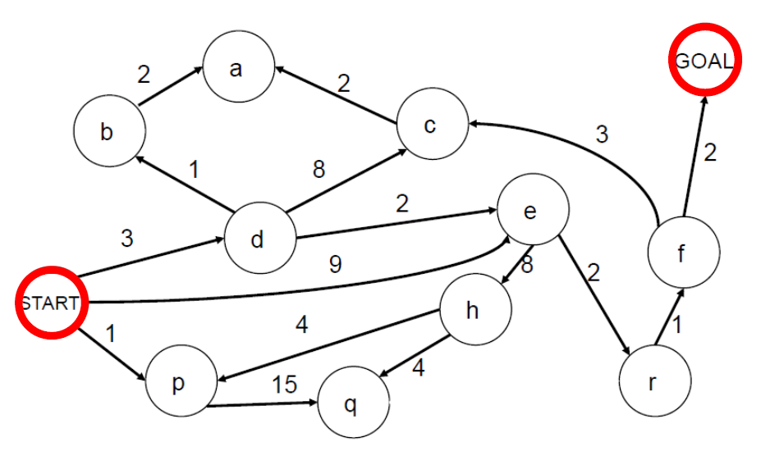
Uniform Cost Search Exercise
Complete the steps:
Current Node | Frontier
 | S0
S0 | P1, d3, e9
p1 | d3, E9, q16
D3 | B4, E5, E9, C11, Q16
? | ?
? | ?

Slide 52



Uniform Cost Search
Current Node | Frontier
 | S0
S0 | P1, d3, e9
p1 | d3, E9, q16
D3 | B4, E5, E9, C11, Q16
B4 | E5, a6, E9, C11, Q16
E5 | a6, r7, E9, C11, h13, Q16
A6 | r7, E9, C11, h13, Q16
R7 | F8, E9, C11, h13, Q16
f8 | E9, g10, C11, c11, h13, Q16
E9 | g10, r11, C11, c11, h13, Q16, H17
g10 | r11, C11, c11, h13, Q16, H17
S, P, D, B, E, A, R, F, E, G

Slide 53
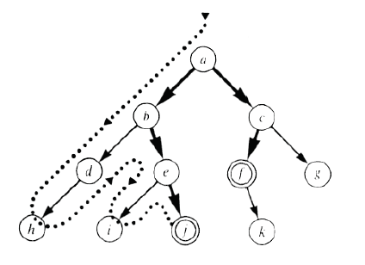
Depth First Search

Slide 54
Depth First Search
Given the following state space (tree search), give the sequence of
visited nodes when using DFS (assume that the node O is the goal
state):
A
B
C
D
E
F
G
H
I
J
K
L
M
N
O

Slide 55
Depth First Search
A,
A
B
C
D
E

Slide 56
Depth First Search
A,B,
A
B
C
D
E
F
G

Slide 57
Depth First Search
A,B,F,
A
B
C
D
E
F
G

Slide 58
Depth First Search
A,B,F,
G,
A
B
C
D
E
F
G
K
L

Slide 59
Depth First Search
A,B,F,
G,K,
A
B
C
D
E
F
G
K
L

Slide 60
Depth First Search
A,B,F,
G,K,
L,
A
B
C
D
E
F
G
K
L
O

Slide 61
Depth First Search
A,B,F,
G,K,
L, O: Goal State
A
B
C
D
E
F
G
K
L
O

Slide 62
Depth First Search
The returned solution is the sequence of operators in the path: A, B, G, L, O
A
B
C
D
E
F
G
K
L
O

Slide 63
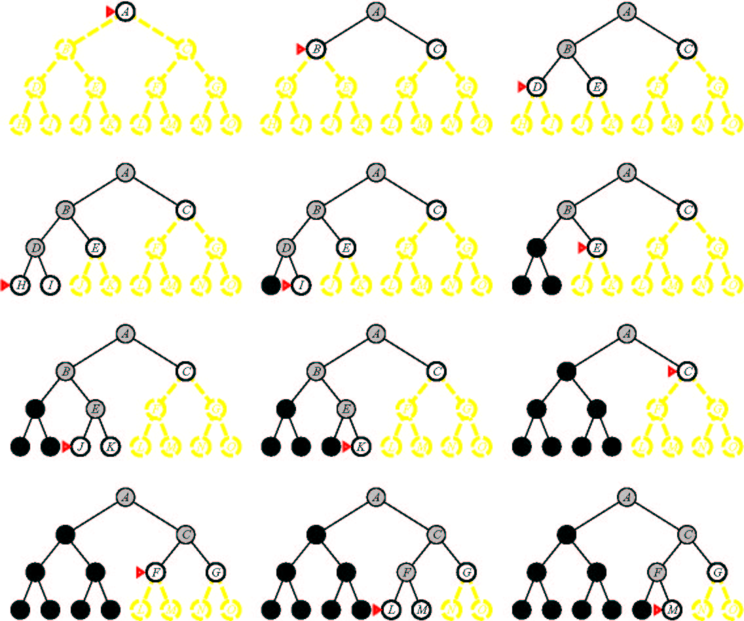
Depth First Search

Slide 64
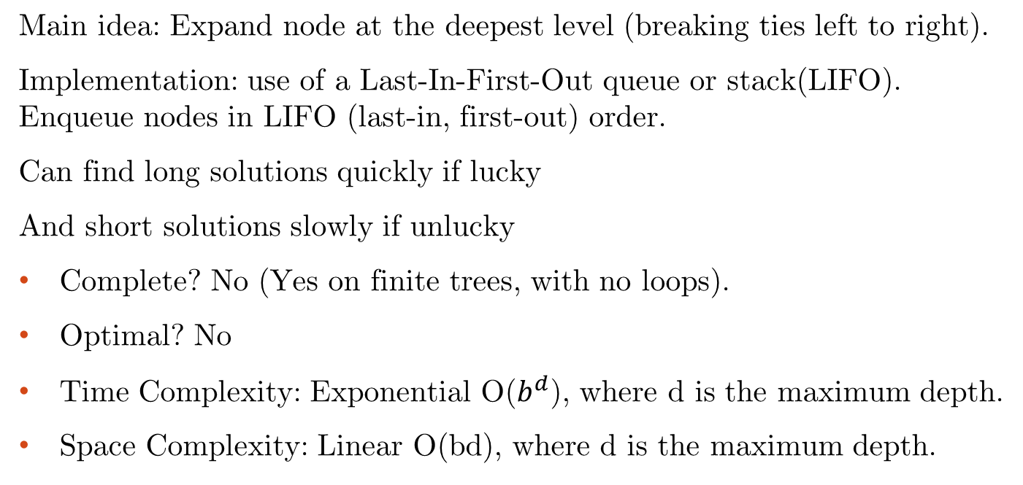
Depth First Search
Main idea: Expand node at the deepest level (breaking ties left to right).
Implementation: use of a Last-In-First-Out queue or stack(LIFO). Enqueue nodes in LIFO (last-in, first-out) order.
Can find long solutions quickly if lucky
And short solutions slowly if unlucky
Complete? No (Yes on finite trees, with no loops).
Optimal? No
Time Complexity: Exponential O($b^{d}$), where d is the maximum depth.
Space Complexity: Linear O(bd), where d is the maximum depth.

Slide 65

Depth-Limited Search (DLS)
Depth Limited Search
Depth Bound = 3

Slide 66
Depth Limited Search
Given the following state space (tree search), give the sequence of
visited nodes when using DLS (Limit = 2):
Limit = 0
A
Limit = 1
B
C
D
E
Limit = 2
F
G
H
I
J
K
L
M
N
O

Slide 67
Depth-Limited Search (DLS)
Depth Limited Search
A,
A
B
C
D
E
Limit = 2

Slide 68
Depth-Limited Search (DLS)
Depth Limited Search
A,B,
A
B
C
D
E
Limit = 2
F
G

Slide 69
Depth-Limited Search (DLS)
Depth Limited Search
A,B,F,
A
B
C
D
E
Limit = 2
F
G

Slide 70
Depth-Limited Search (DLS)
Depth Limited Search
A,B,F,
G,
A
B
C
D
E
Limit = 2
F
G

Slide 71
Depth-Limited Search (DLS)
Depth Limited Search
A,B,F,
G,
C,
A
B
C
D
E
Limit = 2
F
G
H

Slide 72
Depth-Limited Search (DLS)
Depth Limited Search
A,B,F,
G,
C,H,
A
B
C
D
E
Limit = 2
F
G
H

Slide 73
Depth-Limited Search (DLS)
Depth Limited Search
A,B,F,
G,
C,H,
D,
A
B
C
D
E
Limit = 2
F
G
H
I
J

Slide 74
Depth-Limited Search (DLS)
Depth Limited Search
A,B,F,
G,
C,H,
D,I
A
B
C
D
E
Limit = 2
F
G
H
I
J

Slide 75
Depth-Limited Search (DLS)
Depth Limited Search
A,B,F,
G,
C,H,
D,I
J,
A
B
C
D
E
Limit = 2
F
G
H
I
J

Slide 76
Depth-Limited Search (DLS)
Depth Limited Search
A,B,F,
G,
C,H,
D,I
J,
E
A
B
C
D
E
Limit = 2
F
G
H
I
J

Slide 77
Depth-Limited Search (DLS)
Depth Limited Search
A,B,F,
G,
C,H,
D,I
J,
E, Failure
A
B
C
D
E
Limit = 2
F
G
H
I
J

Slide 78
Depth Limited Search
DLS algorithm returns Failure (no solution)
The reason is that the goal is beyond the limit (Limit =2): the goal depth is (d=4)
A
B
C
D
E
Limit = 2
F
G
H
I
J
K
L
M
N
O

Slide 79
Depth Limited Search
It is simply DFS with a depth bound.
Searching is not permitted beyond the depth bound.
Works well if we know what the depth of the solution is.
Termination is guaranteed.
If the solution is beneath the depth bound, the search cannot find the goal (hence this search algorithm is incomplete).
Otherwise use Iterative deepening search (IDS).

Slide 80
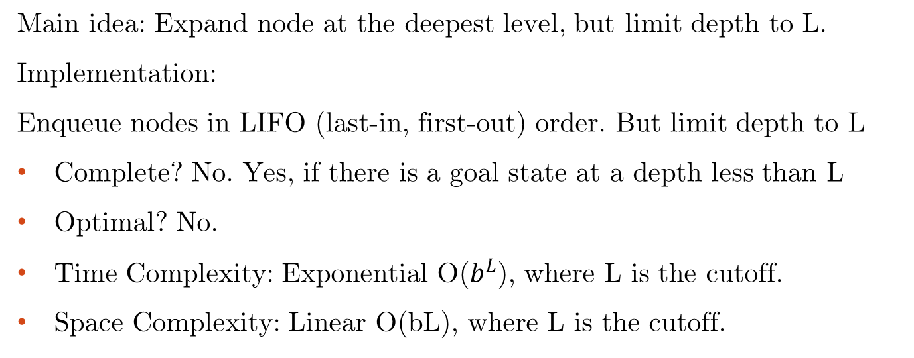
Depth Limited Search
Main idea: Expand node at the deepest level, but limit depth to L.
Implementation:
Enqueue nodes in LIFO (last-in, first-out) order. But limit depth to L
Complete? No. Yes, if there is a goal state at a depth less than L
Optimal? No.
Time Complexity: Exponential O($b^{L}$), where L is the cutoff.
Space Complexity: Linear O(bL), where L is the cutoff.

Slide 81
Iterative Deepening Search (IDS)
Depth First Iterative Deepening (DFID) or Iterative Deepening Search (IDS)
1. DFS to depth 0 (i.e., treat start node as having no successors)
2. Iff no solution, do DFS to depth 1
Has advantage of both BFS (completeness) and DFS (limited space, finds longer paths more quickly)
Generally preferred for large state spaces where solution depth is unknown

Slide 82
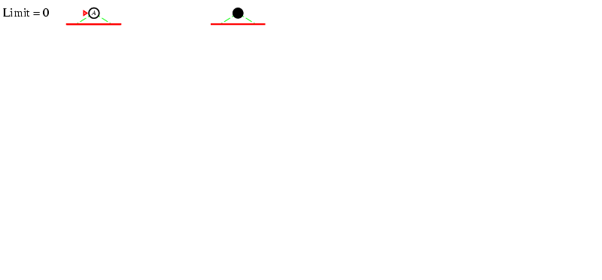
Iterative deepening search L=0
Iterative Deepening Search (IDS)

Slide 83
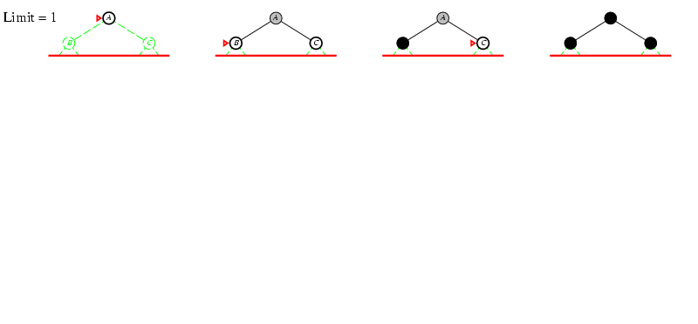
Iterative deepening search L=1
Iterative Deepening Search (IDS)

Slide 84
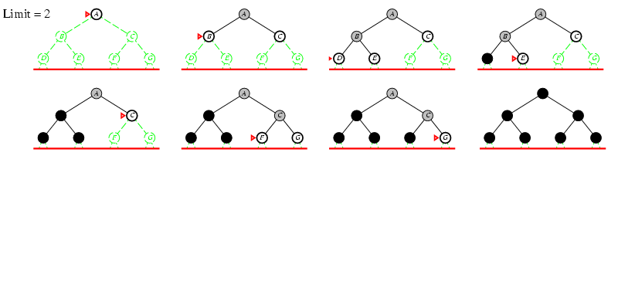
Iterative deepening search L=2
Iterative Deepening Search (IDS)

Slide 85
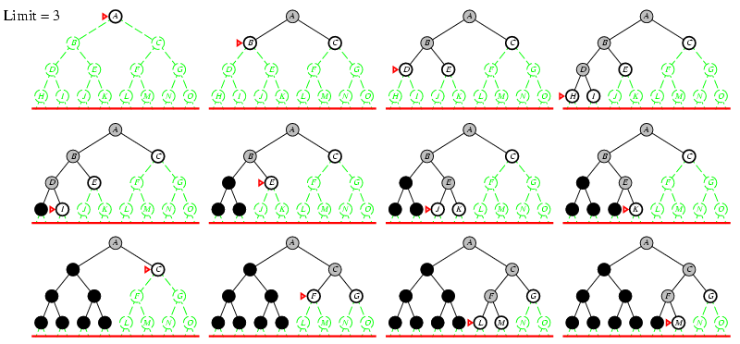
Iterative Deepening Search L=3
Iterative Deepening Search (IDS)

Slide 86
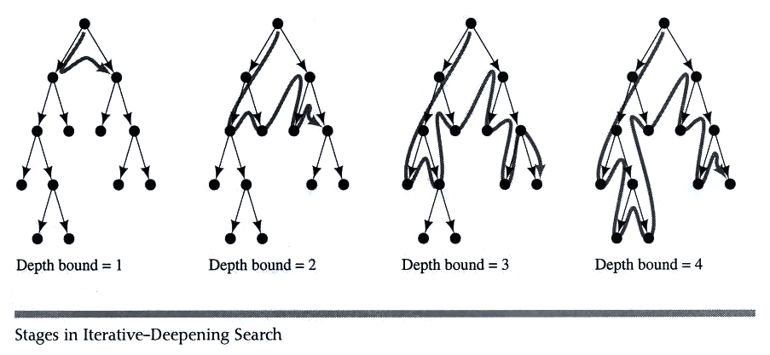
Iterative deepening search
Iterative Deepening Search (IDS)

Slide 87
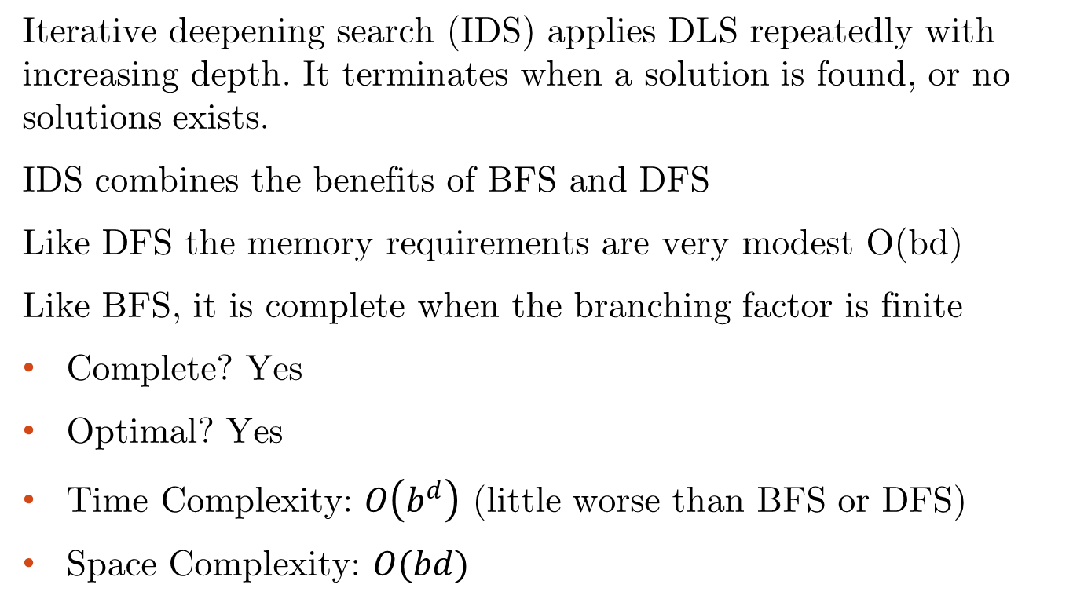
Iterative Deepening Search (IDS)
Iterative Deepening Search (IDS)
Iterative deepening search (IDS) applies DLS repeatedly with increasing depth. It terminates when a solution is found, or no solutions exists.
IDS combines the benefits of BFS and DFS
Like DFS the memory requirements are very modest O(bd)
Like BFS, it is complete when the branching factor is finite
Complete? Yes
Optimal? Yes
Time Complexity: $O\left(b^{d}\right)$ (little worse than BFS or DFS)
Space Complexity: $O(bd)$

Slide 88
Iterative Deepening Search (IDS)
Iterative Deepening Search (IDS)
Seems wastefull becuase states are generated multiple times
But not like that, it is as efficient as BFS or DFS; because majority of the nodes are in the deepest level
For BFS total number of generated nodes are
  N(BFS) = 1 + b + b² + b³ + … … + b^{d}
  = (1 – b^{d+1}) / (1 – b )
For Iterative Deepening Search
Nodes at bottom level (depth d) are generated once
Next to bottom generated twice
The total number of generated nodes is
  N(IDS)= db + (d-1)b² + (d-2)b³ + … … + (1)b^{d} + (d+1)

Slide 89
Iterative Deepening Search (IDS)
Iterative Deepening Search (IDS)
Coparison between BFS and IDS
  Let a tree of depth 4 and branching factor of 10
  For BFS total number of generated nodes are
  N(BFS) = 1 + b + b² + b³ + … … + b^{d}
  = (1 – b^{d+1}) / (1 – b )
  = (1 – 10⁴⁺¹) / (1 – 10)
  = 11,111 nodes
  For Iterative Deepening Search (IDS)
    The total number of generated nodes is
  N(IDS)= (d+1)b⁰ + db¹ + (d-1)b² + (d-2)b³ + … … + (1)b^{d}
  = (4 + 1) + 4 * 10 + 3 + 100 + 2 * 1000 + 10000
  = 12,345 nodes
  In general, iterative deepening is the preferred uninformed search method when there is a large search space and the depth of the solution is not known.

Slide 90
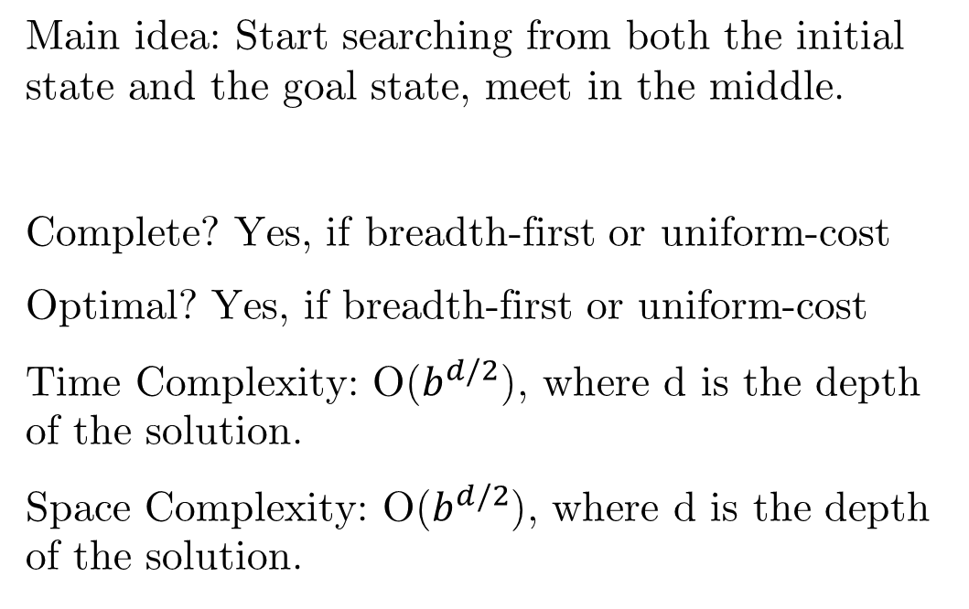
Bi-Directional Search (BDS)
Main idea: Start searching from both the initial state and the goal state, meet in the middle.
Complete? Yes, if breadth-first or uniform-cost
Optimal? Yes, if breadth-first or uniform-cost
Time Complexity: O($b^{d/2}$), where d is the depth of the solution.
Space Complexity: O($b^{d/2}$), where d is the depth of the solution.

Slide 91
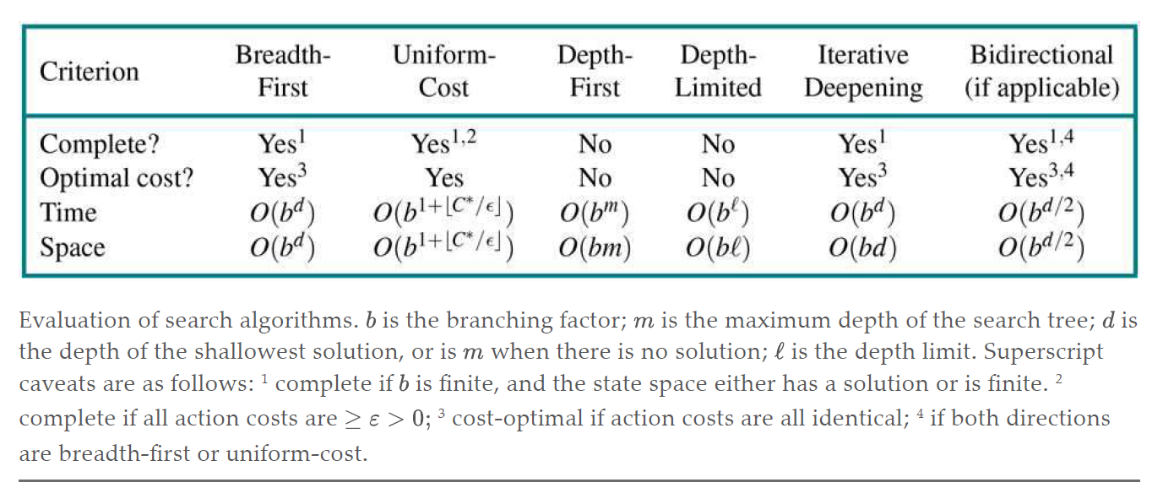
Comparing Uninformed Search Methods

Slide 92
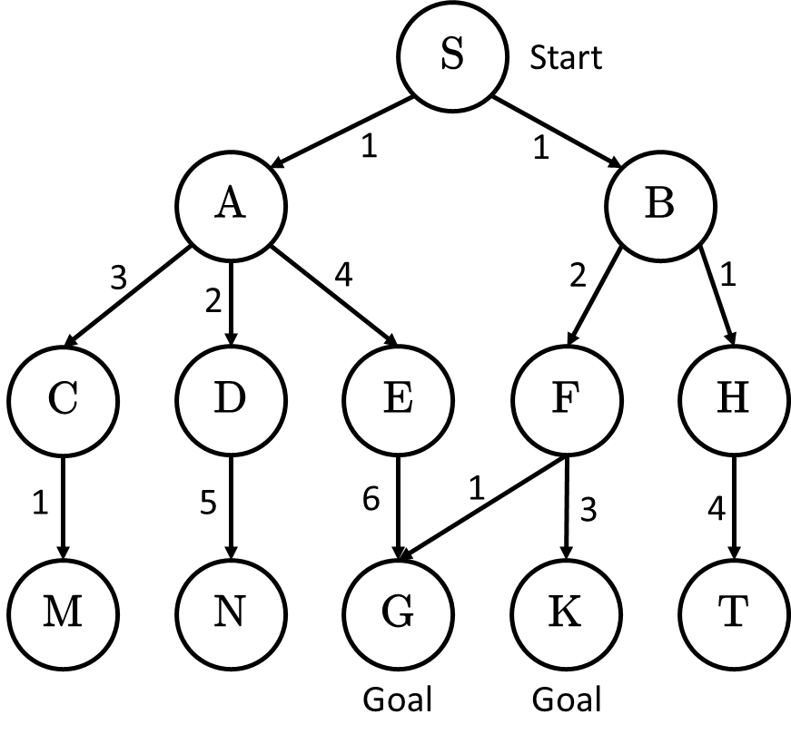
Exercise
Solve the tree by applying BFS, DFS, UCS, DLS, IDS, and BDS.

Slide 93
Summary
Search: process of constructing sequences of actions that achieve a goal given a problem.
The studied methods assume that the environment is observable, deterministic, static and completely known.
Goal formulation is the first step in solving problems by searching. It facilitates problem formulation.
Formulating a problem requires specifying four components: Initial states, operators, goal test and path cost function. Environment is represented as a state space.
A solution is a path from the initial state to a goal state.
Search algorithms are judged based on completeness, optimality, time complexity and space complexity.
Several search strategies: BFS, UCS, DFS, DLS, IDS, BDS
All uninformed searches have an exponential time complexity – hopeless as a viable problem-solving mechanism (unless you have a quantum computer!)

Slide 94
Reading
Chapter 03 of the textbook
Pages 81 to 102

